Slide 1
Building Automation Systems
Tom Johanson – DNV KEMA
Senior Engineer

Slide 2
Agenda
Top 10 – What’s new in Building Automation Systems
Benefits of Energy Management Systems
ComEd Rebates for EMS

Slide 3
Top 10 – What’s new in Building Automation Systems

Slide 4
#1: Anytime and anywhere access
“Cloud” services
Mobile to go applications – smart phones
iPad applications
Alerts and alarms for building system operation

Slide 5
#2: Building performance
System data collection, archiving and reporting
Realtime tracking and managing energy usage
Energy and carbon management
Utility bill management

Slide 6
#3: System optimization
Continuous commissioning
Automatic fault detection
Identification of new measures to reduce energy use
Brand names:
JCI: Panoptix
Honeywell: Attune
Enernoc: Efficiency Smart
Utilivisor

Slide 7
#4: Integration of systems
Building systems:
HVAC
Lighting
Security
Life safety
HVAC systems:
Building occupant zones – lights, temperature, ventilation, occupancy
Air handlers
Chillers

Slide 8
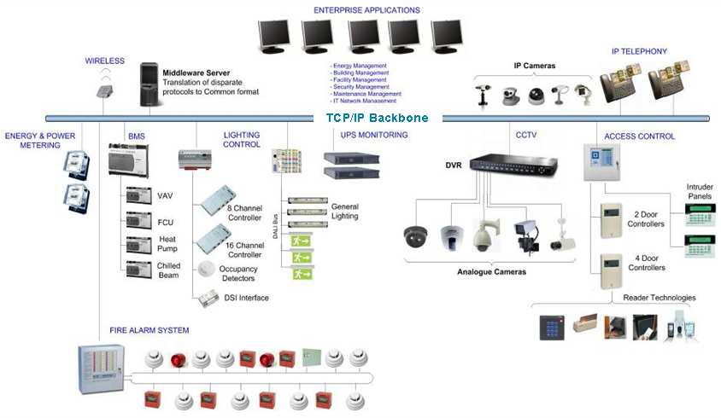
Enterprise – IP Network

Slide 9
#5: Chiller plant optimization
Selects the most efficient configuration of chillers, pumps and towers to meet the load
Brand names:
Siemens: Demand Flow
JCI: Central Plant Optimization

Slide 10
#6: Wireless control
Wireless sensors
Wireless controllers
Wireless mesh network
Easier install for retrofit
More sensors for better control and integration

Slide 11
#7: Demand control ventilation
Adjust the amount of ventilation air based on room occupants (CO2 sensors)
Most beneficial in large areas that have significant times of low occupancy
Enclosed parking garage – CO sensors

Slide 12
#8: Intelligent lighting control
Occupancy sensor at each fixture
Wireless control of fixture
Dimmable fixture to adjust for daylighting or occupant profiles
Warehouse application:
LED lighting
Shorter cycle times such as 10 seconds
Tune light levels
Achieve greater than 95% reduction

Slide 13
#9: Smart Grid integration
Smart grid requires smart buildings
Pre-defined profiles that reduce load based on a signal

Slide 14
#10: Net Zero Energy buildings
Next challenge ahead
Complex controls required
Integration of many systems
Need to react to precise needs of building

Slide 15
Benefits of Energy Management Systems

Slide 16
A Computer-Based System That ...
Controls and monitors HVAC and lighting systems
Monitors, tracks and reports energy use
Helps maintain a safe environment including access security and fire safety
Supports HVAC and lighting systems maintenance
Provides key information for new industry standards

Slide 17
Why Do You Need an EMS?
Maintain occupant comfort and safety
Monitor and reduce energy usage
Maintain automatic and consistent reaction to events (alarms)
Gather and view building information quickly
Obtain diagnostics of HVAC and lighting equipment for predictive maintenance
Communicate corporate sustainability goals

Slide 18
EMS – Other Benefits
Verification that schedule, space temperature and other primary control strategies are working
Easy adaptation to special conditions (such as temperatures and schedules)
Remote trouble-shooting
Anticipation of complaints
Email or mobile device notification of alarms
Complex, multi-input, advanced control strategies
Data trending for optimization
Energy Performance Indicator (EPI) reporting

Slide 19
EMS Common Strategies
Time scheduling
Night set-back or set-up
Lockouts
Resets
Diagnostics

Slide 20
SIFYB Building Automation Projects
527 projects
43.5 GWh saved
Average annual savings of about $8,000 per project
Any health care specific examples?

Slide 21
Healthcare: Issues
Supply air change rates
Outdoor air requirements
Humidification and dehumidification
Simultaneous heating and cooling – high reheating requirements
24/7 operation
Interoperability with other systems
Multi-building campuses
Central chiller/boiler plant

Slide 22
Healthcare: Strategies
Centralized operation
Reduce code required minimum Outside Air requirements during unoccupied periods
Reduce air flow to minimum space ventilation during unoccupied periods
Lower set point during unoccupied periods
Chilled water/condenser water/hot water temperature set point and reset
Supply air temperature, pressure set point and reset
Economizer controls

Slide 23
ComEd Rebates for EMS

Slide 24
New standard measures
Building energy management system (less than 120,000 square foot)
$0.20 per square foot of conditioned space
Demand controlled ventilation: conditioned space
$30 per 1,000 square feet
Demand controlled ventilation: parking garage
Remains as custom incentive through PY5
Air side economizer
$40 per ton

Slide 25
Custom Incentives for PY5
Incentive rate is 7 cents/kWh saved
Early commitment option
For projects that save more than 500,000 kWh
Incentive of 6 cents/kWh saved committed to at approval of pre-application
Separate and more detailed application

Slide 26
Thank you!
Notes:
Laura will be passing out the new marketing material for SIFYB.

