Slide 1
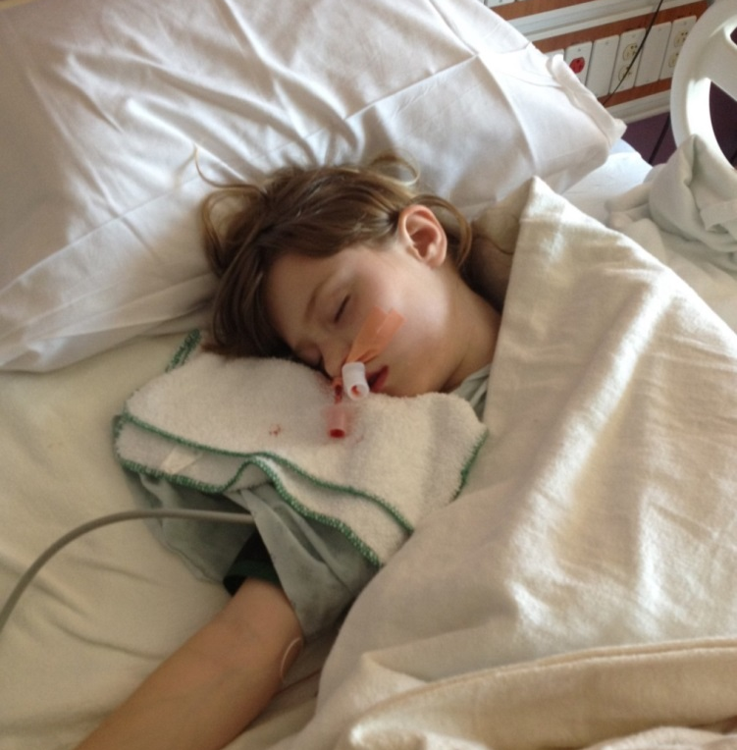
Healthcare Retro-commissioning Real world problems - real world results
By: John D. Villani, P.E., LEED AP, QCxP, CEM, GBE

Slide 2
This Presentation will cover….
Healthcare Retro-commissioning
New Construction Examples
Older Buildings Examples
CHW Systems
Heating Systems
RCx Costs and Business Case

Slide 3
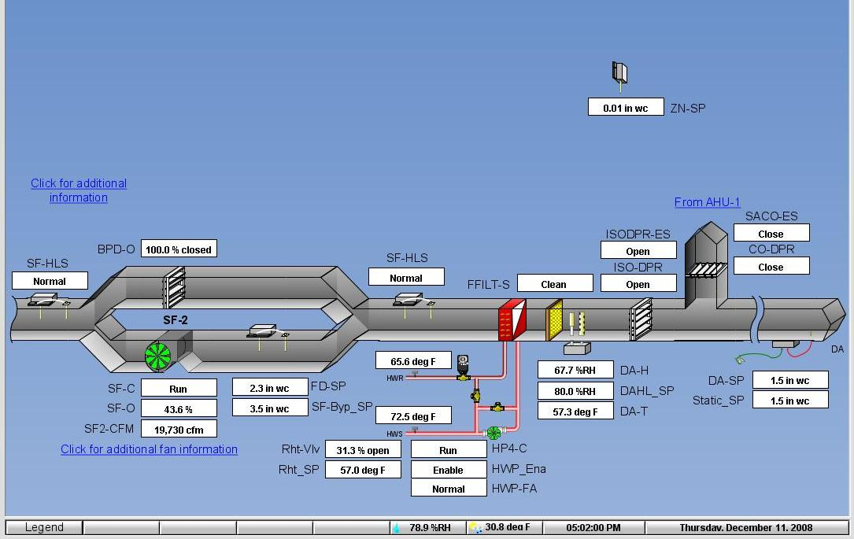
Everything looks good right?
Supply CFM is in range, typically 18 to 23k
DAT is just over the setpoint of 55
Supply Static is at setpoint
Building pressure is at setpoint
SUPPLY SIDE OF AIR HANDLING UNIT
New Construction RCx

Slide 4
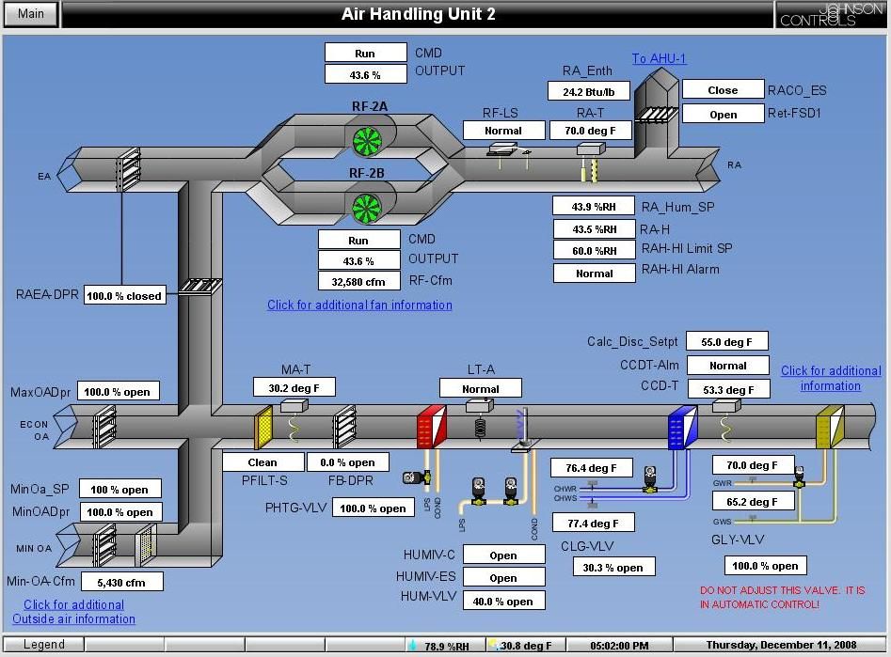
RETURN SIDE OF AIR HANDLING UNIT
Why is the unit in economizer mode?
23.1F Heat Gain

Slide 5
New Construction RCx
Room Pressurization is controlled by actual pressure

Slide 6
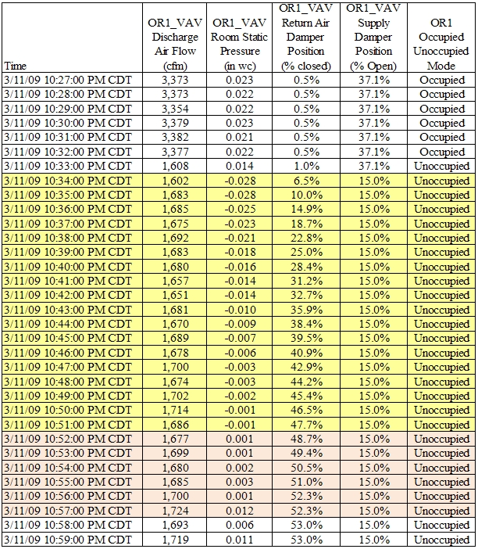
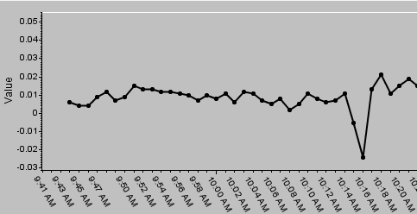
New Construction RCx
Trending showed this happening 3 to 4 times per night per OR
Negative OR Pressurization
Neutral OR Pressurization

Slide 7
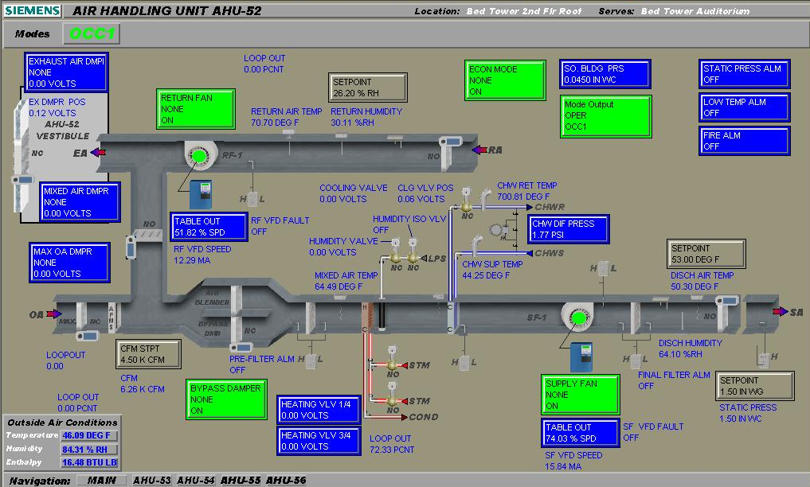
New Construction RCx

Slide 8
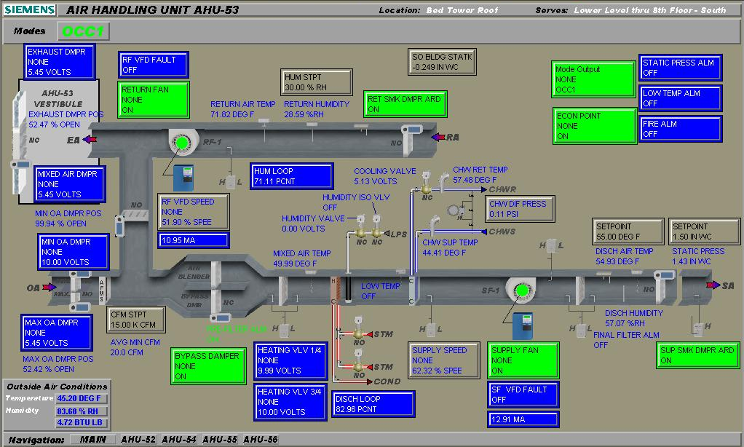
New Construction RCx

Slide 9
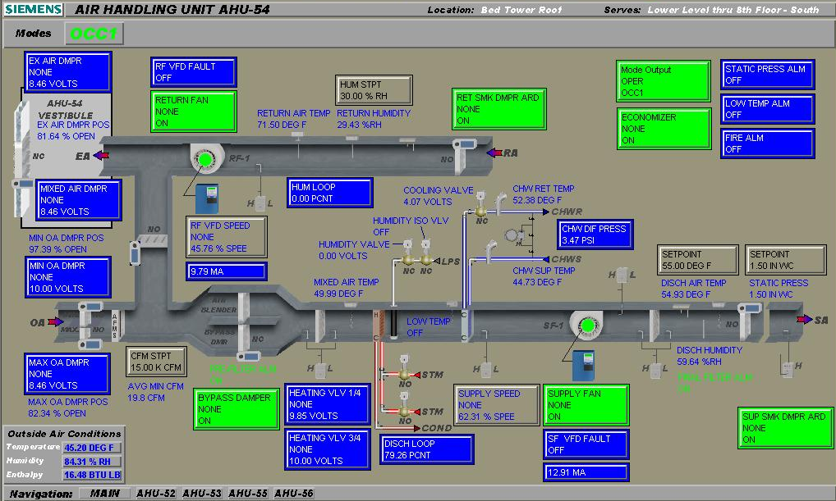
New Construction RCx

Slide 10
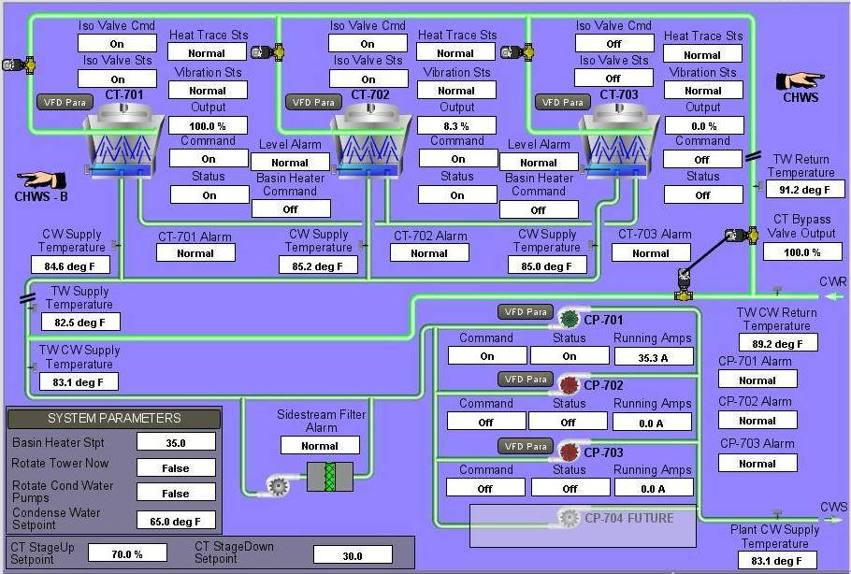
New Construction RCx
CW setpoint is very low, originally forcing all three CT’s on, which caused CW flow to be below minimum on each tower, reprogrammed to only allow two towers to operate with one chiller, but still have unequal loading. Problem with controls programming.

Slide 11
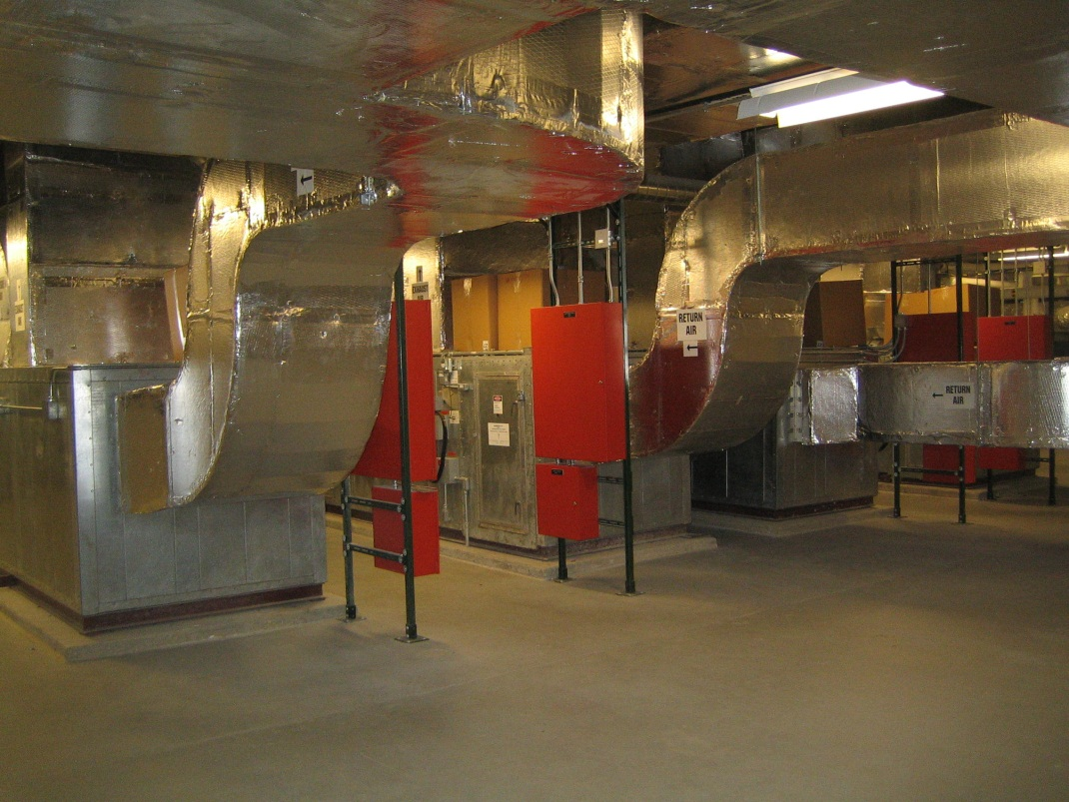
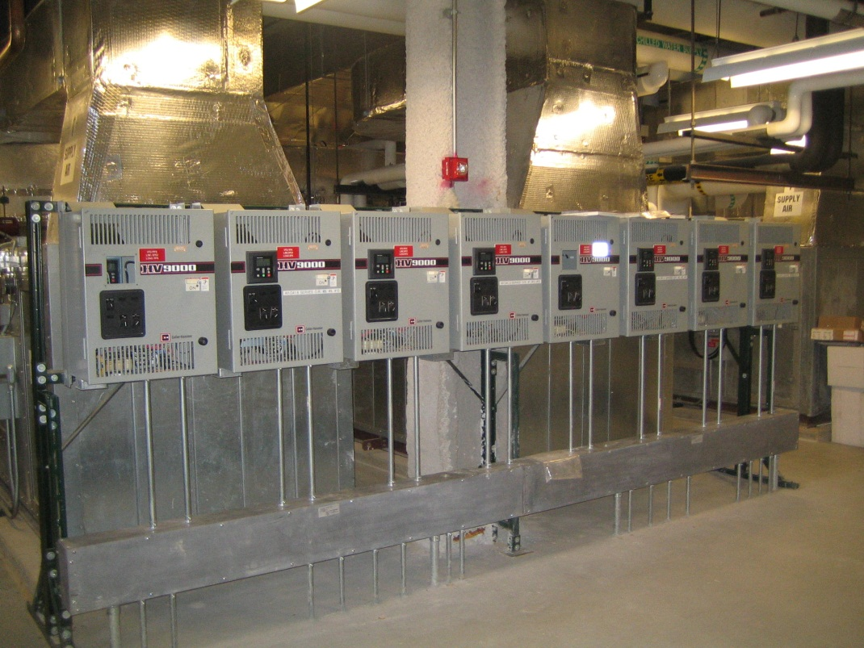
Operating Rooms RCx
4 Operating Room AHUs each serving 3 ORs
Each AHU has supply and return fans with VFDs

Slide 12
Operating Rooms RCx
Most OR’s can be positively pressurized with 6 to 8 air changes per hour,
Let temperature “float” during unoccupied mode with deadband

Slide 13
Operating Rooms RCx Unoccupied Mode for OR’s 1 though 6
Hospital with Level 1 Trauma Center, 4 ORs were decided to be left occupied all the time, ORs 1,2, 11 and 12 (also the biggest)

Slide 14
Operating Rooms RCx Unoccupied Mode for OR’s 7 though 12
California Mechanical Code allows a MINIMUM of 6 ACH, it is not recommended or typically feasible to go below this

Slide 15
Operating Rooms RCx Unoccupied Mode BEFORE Changes

Slide 16
Operating Rooms RCx Unoccupied Mode AFTER Changes

Slide 17
Operating Rooms RCx Unoccupied Mode AFTER Changes
Date/Time | AH.D416.SPRES.SP Static Pressure Setpoint "w.g. | AH.D416.SPRES Actual Static Pressure "w.g. | AH.D416.SVFD Supply Fan VFD % Speed
2/8/2012 7:00 | 1.25 | 1.25 | 77
2/8/2012 6:30 | 1.25 | 1.26 | 77
2/8/2012 6:00 | 1.25 | 1.24 | 29 | UNOCCUPIED TIME PERIOD
2/8/2012 5:30 | 1.25 | 1.25 | 29
2/8/2012 5:00 | 1.25 | 1.25 | 29
2/8/2012 4:30 | 1.25 | 1.26 | 29
2/8/2012 4:00 | 1.25 | 1.25 | 29
2/8/2012 3:30 | 1.25 | 1.25 | 29
2/8/2012 3:00 | 1.25 | 1.25 | 29
2/8/2012 2:30 | 1.25 | 1.25 | 29
2/8/2012 2:00 | 1.25 | 1.25 | 29
2/8/2012 1:30 | 1.25 | 1.26 | 29
2/8/2012 1:00 | 1.25 | 1.25 | 29
2/8/2012 0:30 | 1.25 | 1.25 | 29
2/8/2012 | 1.25 | 1.25 | 29
2/7/2012 23:30 | 1.25 | 1.30 | 35
2/7/2012 23:00 | 1.25 | 1.25 | 77
Different fan than previous screen shots

Slide 18
Operating Rooms RCx Unoccupied Mode AFTER Changes

Slide 19
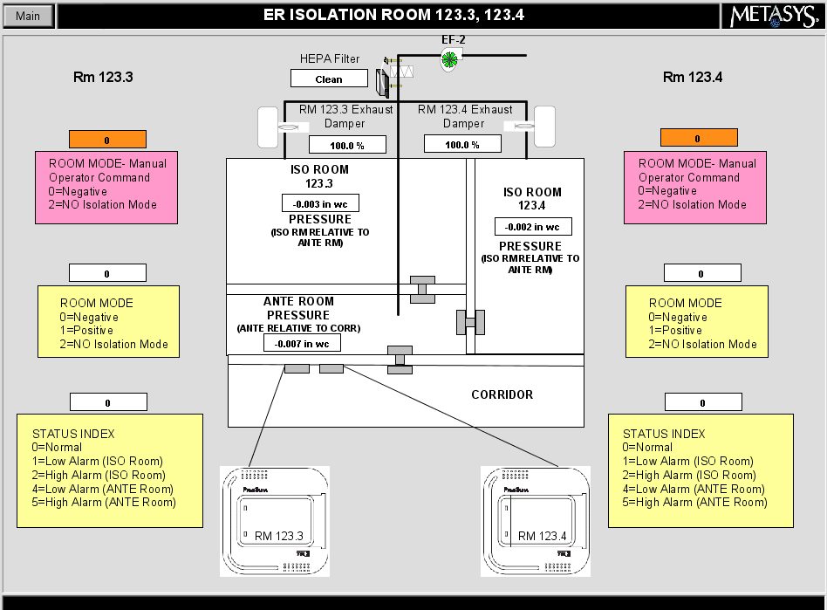
Older Hospital RCx – What will you find? Isolation Rooms
No data on EF-2 is shown, VFD speed, static pressure or static pressure setpoint
ISO Rm 123.3 is in negative mode and not maintaining negative 0.01" w.c.
ISO Rm 123.4 is in negative mode and not maintaining negative 0.01" w.c.
Both ISO Rm's should be in alarm but neither indicate an alarm condition

Slide 20
Older Hospital RCx – What will you find? University of Chicago
Building Type | Hospital
Measures | Supply Air Temperature Reset Night Time Zone Airflow Setback Equipment Operations Scheduling Simultaneous Heating and Cooling HW and CHW Pump Optimization
Incentive | $120,750
Therms Saved | 171,469 estimated
Simple Payback | < 3 months
What about pneumatics??

Slide 21
Older Hospital RCx – What will you find? Hot Water Heating System
Steam valves are commanded closed.

Slide 22
Older Hospital RCx – AHU Scheduling
Scheduling AHUs without shutting them off.

Slide 23
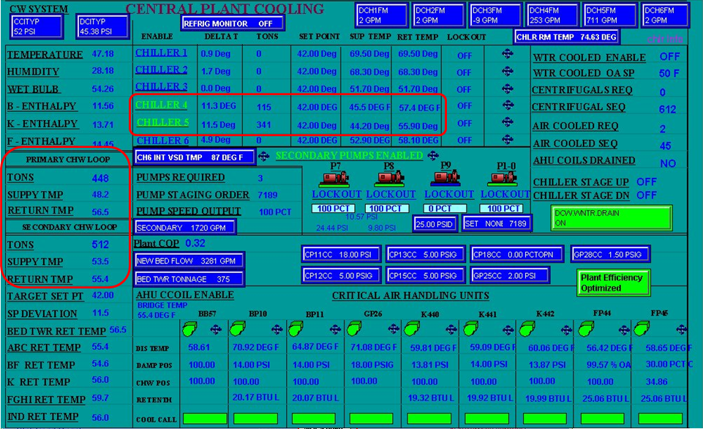
Chilled Water System RCx
Chiller 4&5, 300 tons each, 2gpm/ton = 600gpm each » Primary CHW Loop = 1200gpm
Secondary Pumps are 3000gpm each, P7+P8+P9 are ON @ 100% speed » Sec. CHW Loop = 9000gpm
Primary CHWS Temp = 48 F » Secondary CHWS Temp = 53.5
1200 GPM
9000 GPM
Notes:
Ratepayer funding means that all ComEd customers contribute to the incentive fund.
Take a look at your ComEd bill.
[click] There is a line that says “Energy Efficiency Program” and shows what your company is contributing.
It’s based on kWh usage.
Since you’re paying into the fund, you should consider energy efficiency projects that will repay you in incentives.

Slide 24
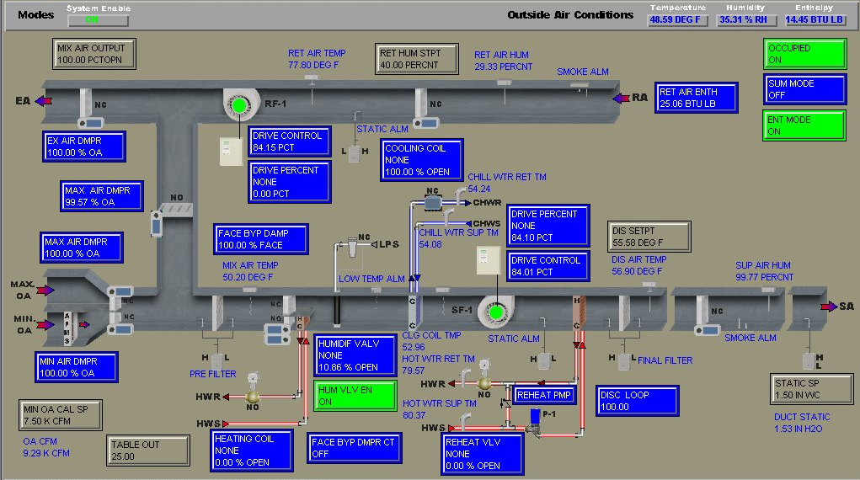
Chilled Water System RCx
Notes:
Ratepayer funding means that all ComEd customers contribute to the incentive fund.
Take a look at your ComEd bill.
[click] There is a line that says “Energy Efficiency Program” and shows what your company is contributing.
It’s based on kWh usage.
Since you’re paying into the fund, you should consider energy efficiency projects that will repay you in incentives.

Slide 25
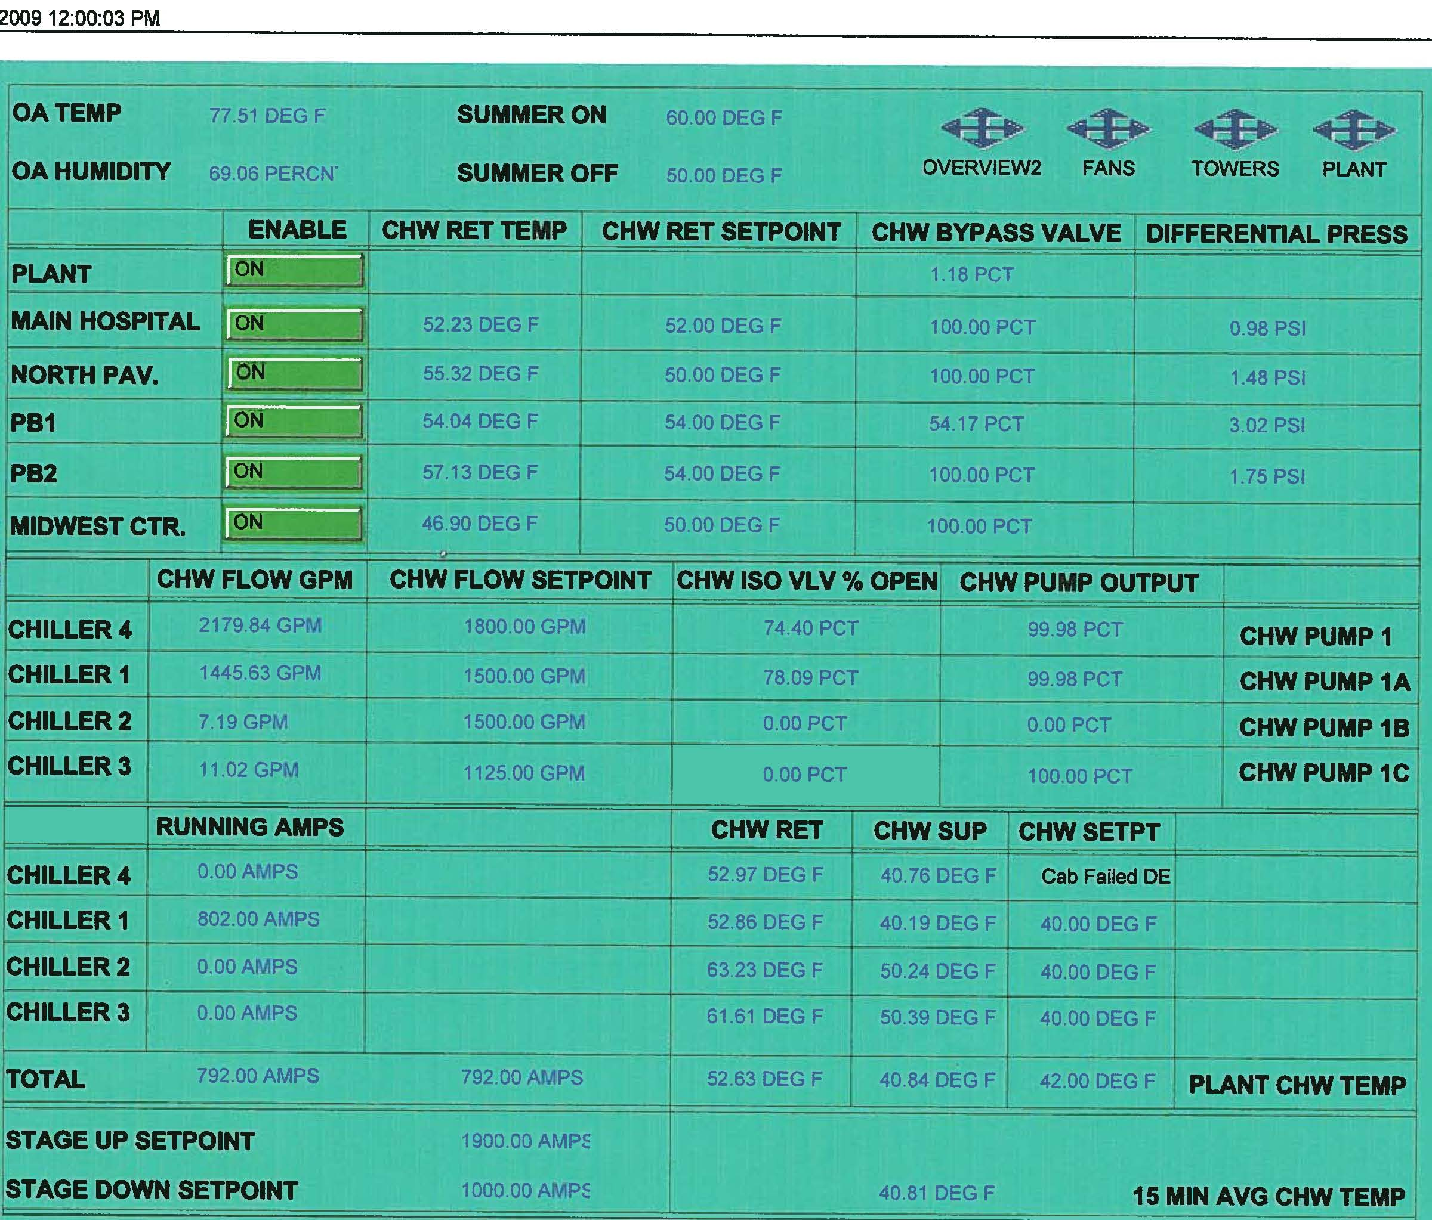
Chilled Water System RCx

Slide 26
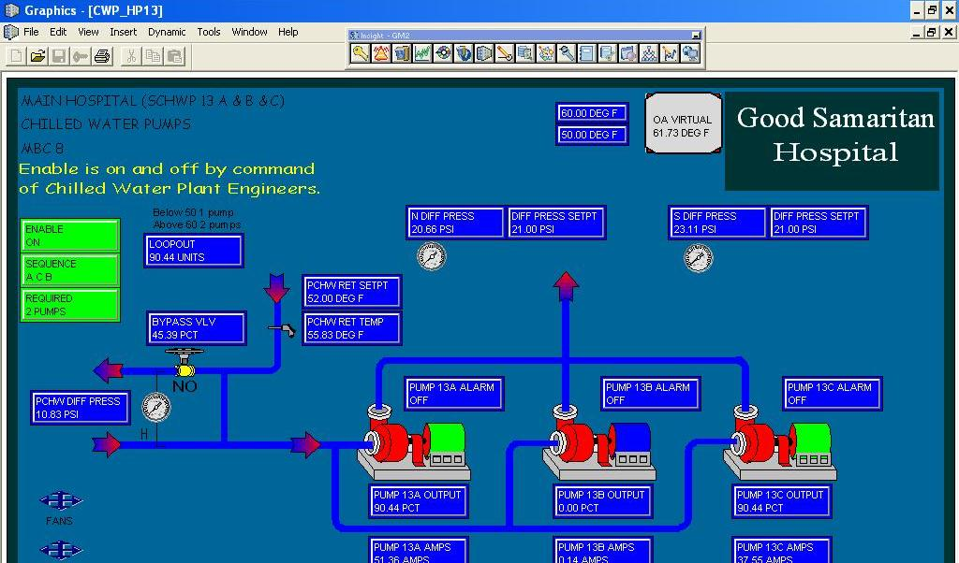
Older Hospital RCx – What will you find? Pumping Systems DP Setpoints - BEFORE

Slide 27
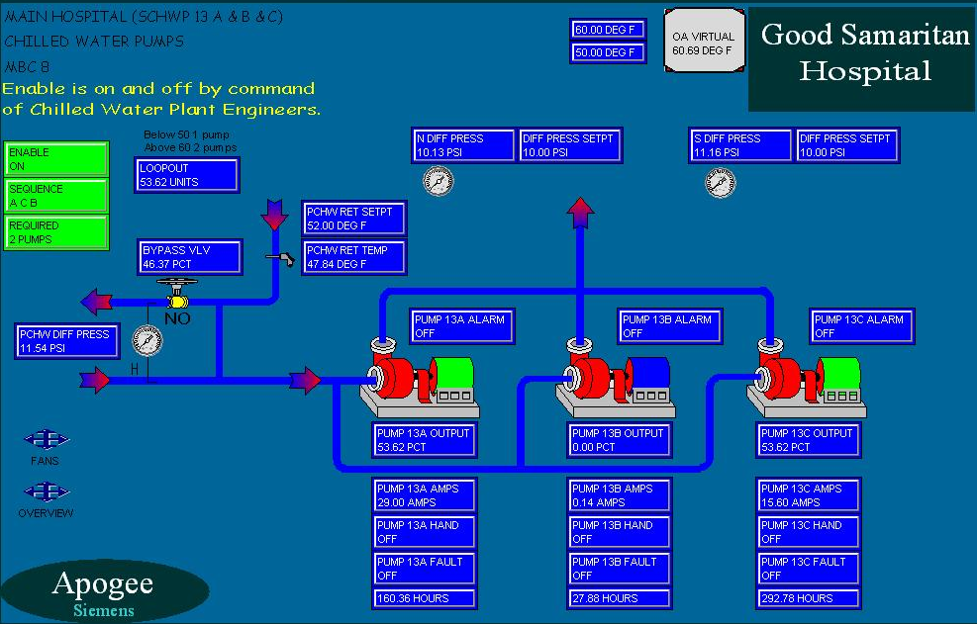
Older Hospital RCx – What will you find? Pumping Systems DP Setpoints - AFTER

Slide 28
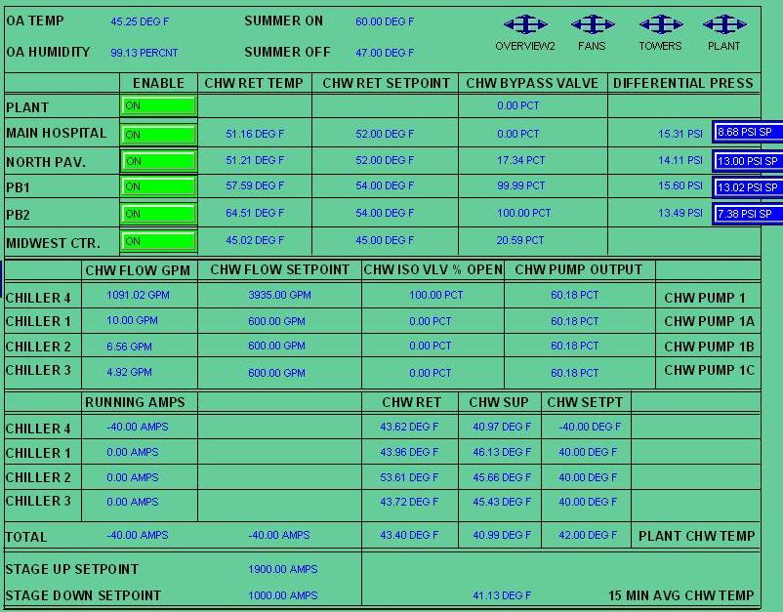
Chilled Water System RCx

Slide 29
Chilled Water System RCx

Slide 30
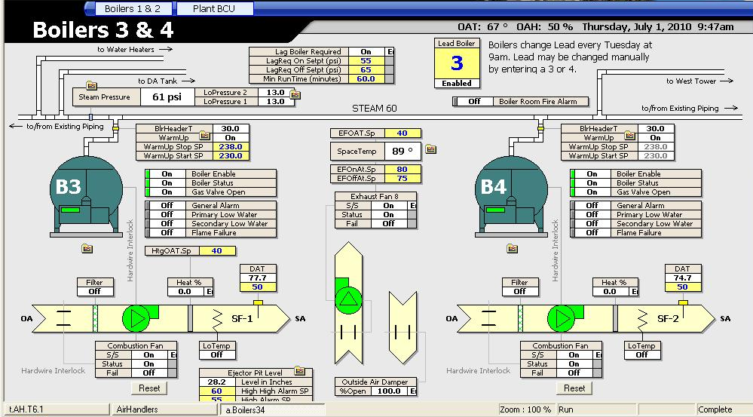
Heating System RCx

Slide 31
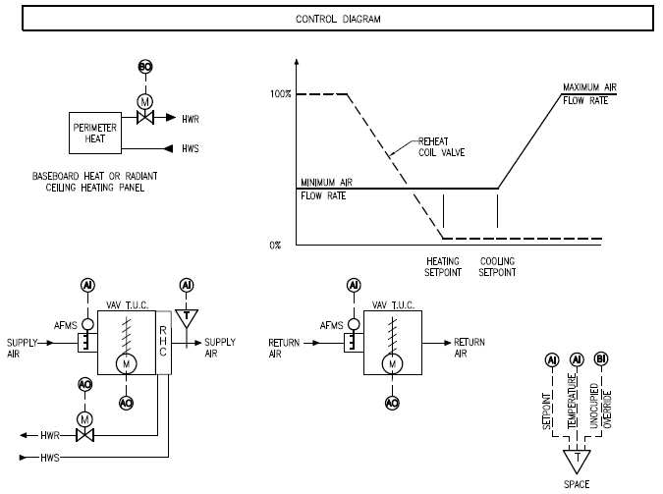
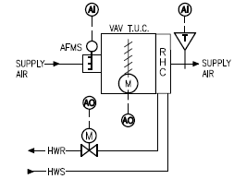
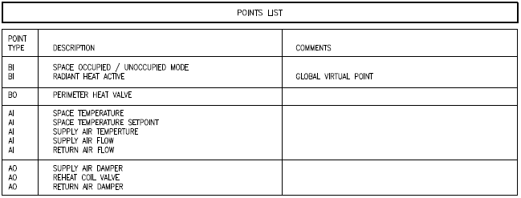
Heating RCx - VAV & Heating Controls
Review unoccupied air flow rates, many systems are not programmed to have unoccupied setpoints!
VAV Controls
Diagram
JCI VMA (VAV) Controller default heating cfm = max cooling cfm
UNOCCUPIED
Review Global points that command systems, this system had radiant heat coming on at 50ºF OA, which overheated the building causing simultaneous heating and cooling.
Tested and adjusted by building exposure, final setpoints ranged from 45 to 35 degrees OA

Slide 32
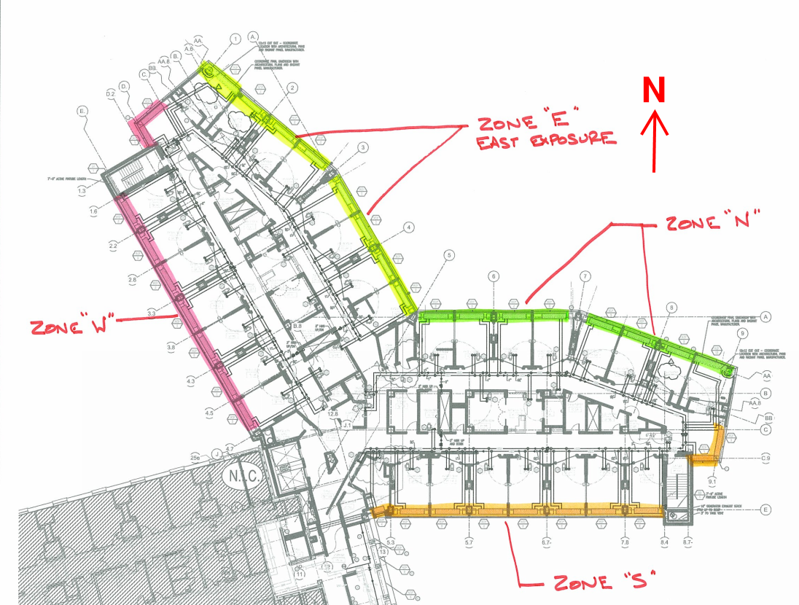
Heating RCx - Radiant Panels broken down by exposure
Revised Radiant Panel Zoning Diagram
Cx tested and adjusted radiant heating by building exposure, final setpoints ranged from 45 to 35 degrees OA, originally 50

Slide 33
RCx Cost and Time
Cost
Planning and Investigation Phase ($5K-$10K est.)
Implementation ($15K-$30K minimum spend commitment)
Disconnect between Finance and Operations
Time
8 to 12 months total
4 hours per week, operations support
Building Engineers
Electrician Support
Management Support
BAS Support

Slide 34
Business Case
Energy Savings $$$ Example
Assume a 5% total energy savings
600,000 Square Feet
$3.50/Square Feet Energy Spend
$2,100,000 Annual Energy Spend
$105,000 ENERGY SAVINGS
Average Hospital RCx Energy Savings (based on 14 million Sq.Ft. comprised of 18 projects)
4.2% Avg. Electrical Savings (kWh) (Range 1.4% to 15.3%)
6.1% Avg. Natural Gas Savings (therms) (Range 1.2% - 27.3%)
Beware of industry norm of 15% savings (not typical in hospitals)

Slide 35
Business Case
Cost
Average payback is ½ year simple payback
$105,000 / 2 = Implementation Cost $52,500
Plus Planning and Investigation Phase Costs (assume $7,500)
BOC Training Cost $1000 (8 full days)
Total Cost = $61,000
CAN YOU SPEND THIS OUT OF THE OPERATING BUDGET??
Determine the project size and scope based on budget
NO cost for RSP engineering services
NO cost for Nexant program management services

Slide 36
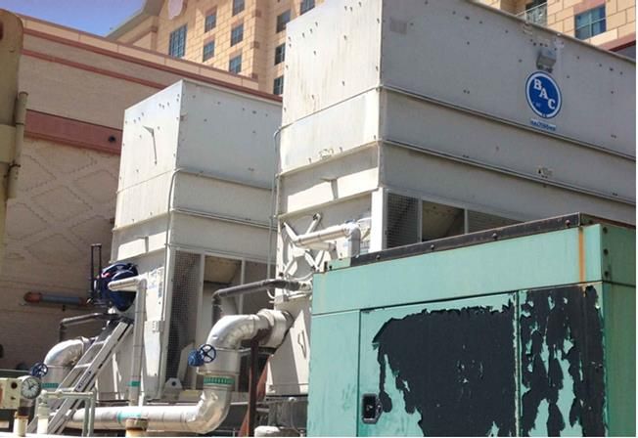
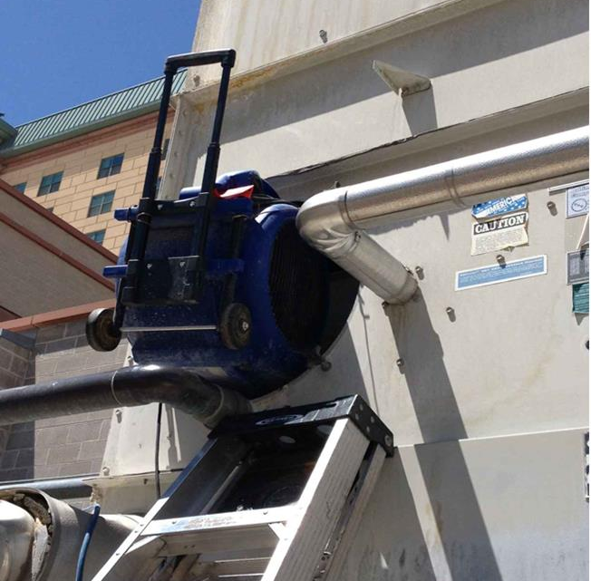
Thank You/Questions: Are we having fun yet?
Who knows how to supercharge your cooling tower?
Cooling Tower Supercharger Fan
Grumman/Butkus Associates
Energy Efficiency Consultants
and Sustainable Design Engineers
John Villani, P.E., LEED AP, QCxP, CEM, GBE jvillani@grummanbutkus.com

